Slide 1
Predicting PMGSY Scheme Eligibility using Machine Learning
CAPSTONE PROJECT
Presented By:
Student name : Achyuta Samantaray
College Name & Department : Institute of Technical Education and Research (SOA), Computer Science

Slide 2
OUTLINE
Problem Statement
Proposed System/Solution
System Development Approach
Algorithm & Deployment
Result (Output Image)
Conclusion
Git-hub Link
Future Scope
References
IBM Certifications

Slide 3
Problem Statement
Pradhan Mantri Gram Sadak Yojana (PMGSY) has several plans - PMGSY-I, PMGSY-II and RCPLWEA and each of them has its own eligibility criteria.
In the current situation, manually determining under which scheme a project falls is slow, inaccurate and not efficient. This causes the rural infrastructure planning to be delayed, wastes available resources and there is no openness in decision-making.

Slide 4
Proposed Solution
The system that is proposed provides a way of overcoming this problem of properly identifying the rural infrastructure projects with the corresponding PMGSY scheme ( PMGSY-I, PMGSY-II, RCPLWEA, etc. ) Manual system can be error prone and time consuming. This system uses machine learning applied by IBM Watson Auto-AI and it improves the speed, consistency and transparency of schemes allocation. The solution is going to include the following elements:
Data Collection:
Collected government datasets from AI Kosh, including project-level details such as road length, cost, sanction year, state and district.
These features directly influence the eligibility and assignment under various PMGSY schemes.
Data Preprocessing:
Clean and preprocess the collected data to handle missing values, outliers and inconsistencies.
Performed basic feature engineering to ensure numerical and categorical fields are properly interpreted by Auto-AI.
Machine Learning Algorithm:
Used IBM Watson Auto-AI to automatically test, tune and compare multiple ML models (Random Forest, XGBoost, Logistic Regression, etc.).
Consider Selected the best-performing pipeline based on model accuracy and performance.
Target column: PMGSY scheme type (e.g., PMGSY-I, PMGSY-II, RCPLWEA)
Deployment:
Deployed the final model using Watson Machine Learning.
Deploy the solution on a scalable and reliable platform, considering factors like server infrastructure, response time and user accessibility.
Ensured the deployed service is accessible and scalable for integration in government planning systems.

Slide 5
Proposed Solution
Evaluation:
Auto-AI provided detailed metrics like accuracy, precision and confusion matrix for multiclass classification.
Model was evaluated on a test dataset to validate its ability to generalize.
More adjustment or re-training can be done with up-to-date datasets in the future.
Result:
The accuracy of the Auto-AI-selected model was very good in the classification of infrastructure projects to the right PMGSY schemes.
It will be possible to significantly minimize manual work effort, increase the accuracy of classification and speed up the decision-making process in the domain of rural progress with the help of the offered solution.

Slide 6
System Approach
The "System Approach" section outlines the overall strategy and methodology for developing and deploying the PMGSY scheme classification system. Below is the customized structure for your project:
System requirements
IBM Cloud Lite account
IBM Watson Studio environment
Internet connection and browser access
IBM Cloud Object Storage (for dataset upload)
IBM Watson Machine Learning (for model deployment)
Library required to build the model
Auto AI framework (built-in inside Watson Studio)
scikit-learn – Used under the hood for ML pipelines
REST API utilities – For integrating model post-deployment

Slide 7
Algorithm & Deployment
Algorithm Selection:
We utilized IBM Auto-AI, a no-code machine learning automation tool, which tests numerous classification algorithms like: Random Forest, Gradient Boosting, Logistic Regression, XGBoost and many others
Auto-AI automatically picks out the most efficient algorithm on the grounds of accuracy and F1 score. Our last choice of models was the Random Forest Classifier that showed very good performance with respect to multiclass classification.
Data Input:
The model was trained using the following input features from the PMGSY dataset:
Road Length (in km)
Project Cost
Year of Sanction
State Name
District Name
The target variable was the Scheme Type, which includes categories like PMGSY-I, PMGSY-II and RCPLWEA.

Slide 8
Algorithm & Deployment
Training Process:
Data that has been preprocessed was stored in IBM Watson Studio.
Auto AI handled: Train-test split, Feature selection, Pipeline generation, Model tuning and evaluation
Some of the techniques used on the platform included cross-validation and the automatic tuning of hyperparameters in selecting the most robust model.
Prediction Process:
After training, the most suitable modeling was established to cover the greatest model with IBM Watson Machine Learning via REST API endpoint.
New project data (length, cost, year, state, district) can be sent to this endpoint.
Using the model, you will get the answer of the PMGSY scheme in real-time and you will be able to give the eligibility classification immediately.

Slide 9
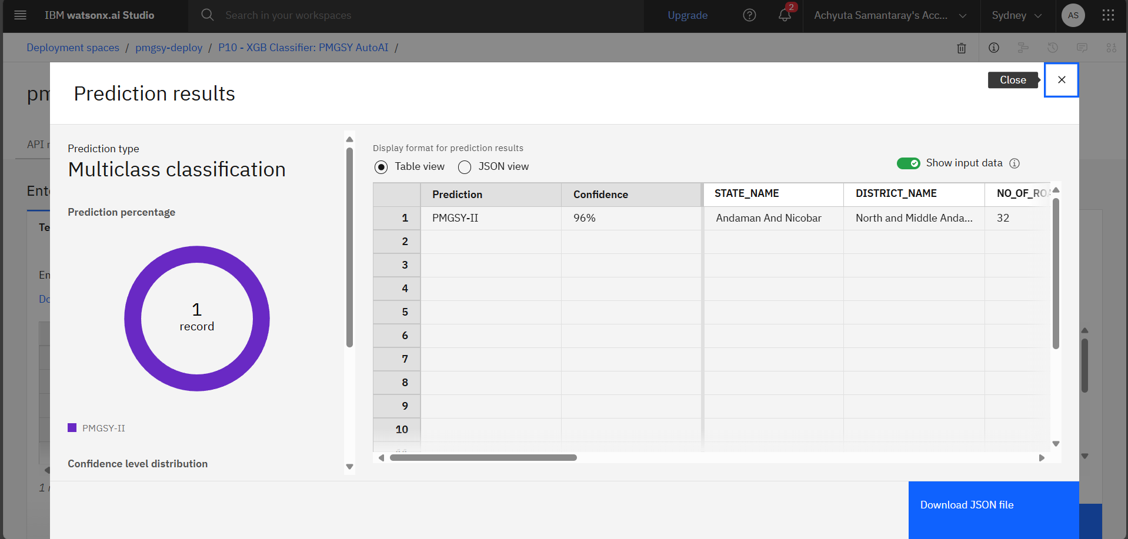
Result
IT carries out multiclass classification to determine schemes, It also shows confidence levels of prediction (e.g., 96%) as well as geographic information (state/district) and returns results that can be analyzed and integrated in tabular and JSON structures.
Prediction Results – Table View

Slide 10
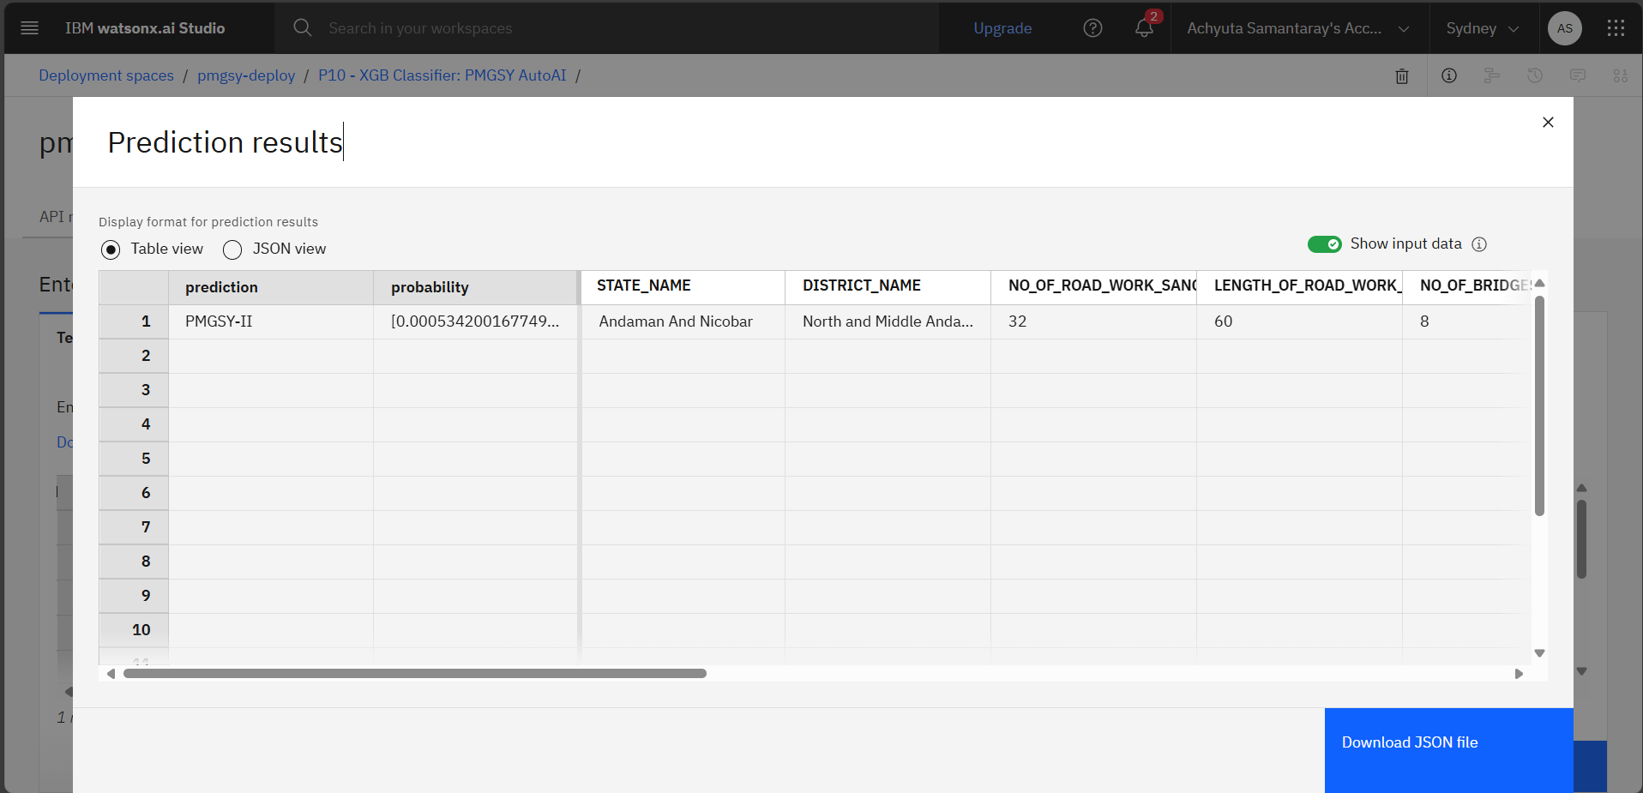
Result
Prediction Results – Showing Input Data

Slide 11
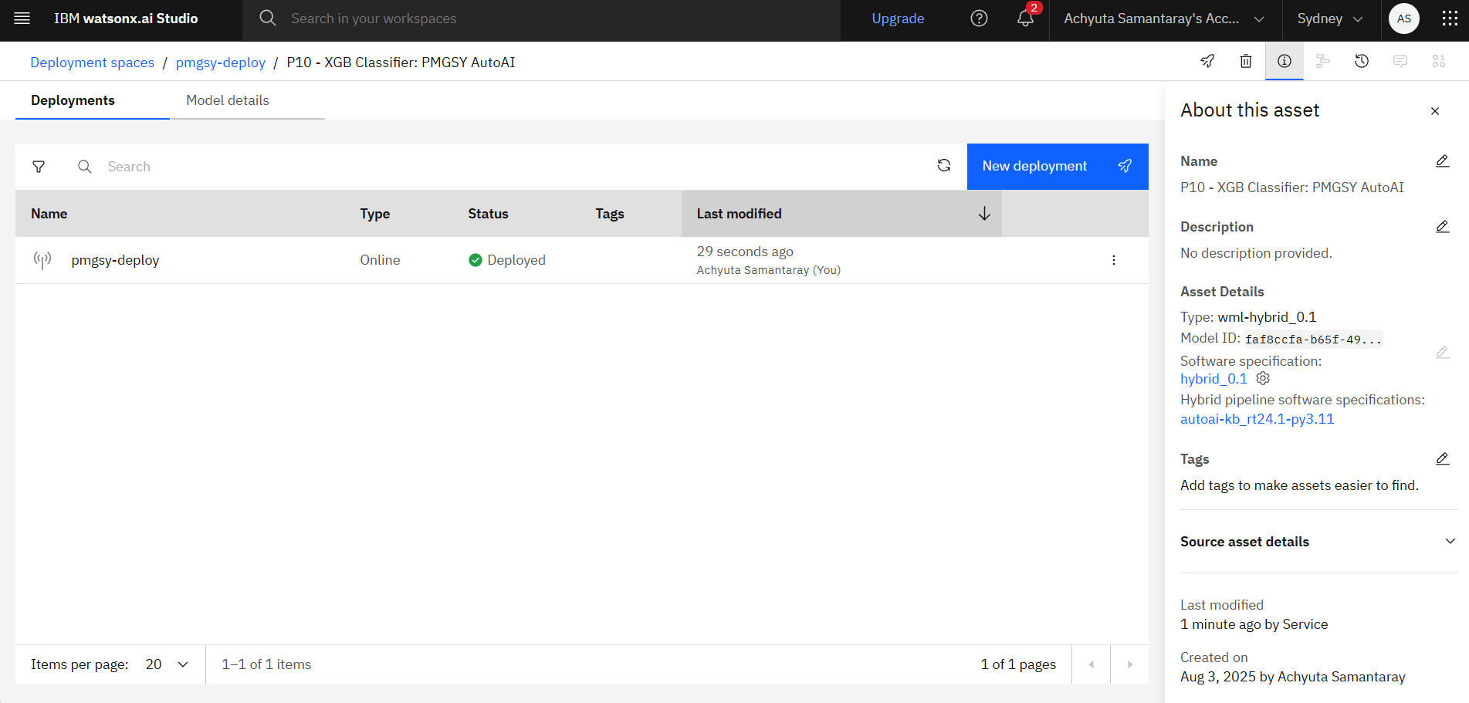
Result
Project Deployment

Slide 12
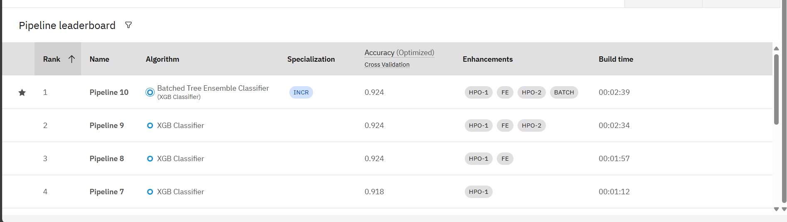
Result
This ranking is a list of most accurate AI models to predict schemes. The best model (Pipeline 30) is based on XGB Classifier and it has the accuracy of 92.4 percent. Models are sorted into the accuracy and building time.

Slide 13
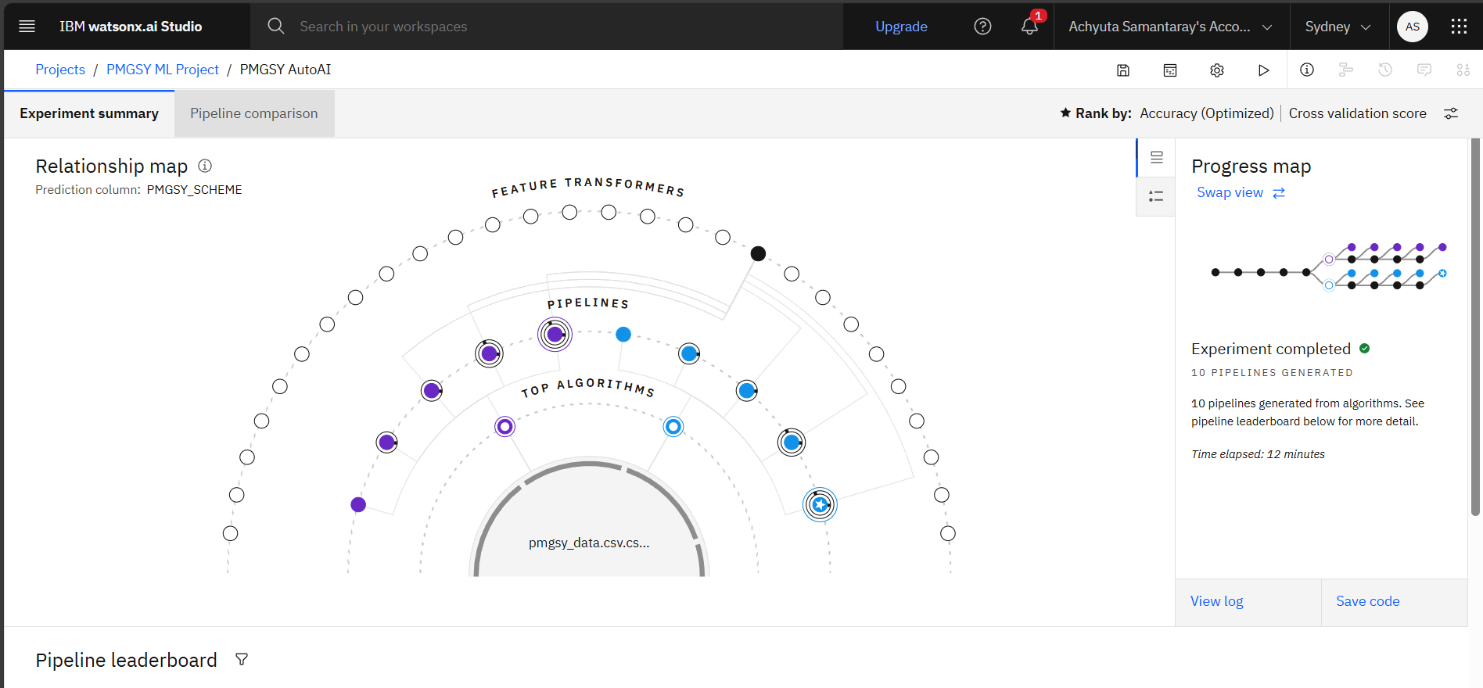
Result
Relationship Map

Slide 14
Conclusion
The objectives of the project have been met because it has pointed to how machine learning can specifically IBM Watson Auto- AI can be employed in automating the process in which the rural infrastructures can be grouped with the appropriate schemes within the PMGSY. A high degree of precision to the minimal degree of manual input was achieved by the Auto-AI created model that used the corresponding features i.e. the length, cost, location of the road and the year it was sanctioned.
This smart system has the potential of adding huge efficiency in the usage of government schemes and transparency in their allocation and eliminating human error and faster decision making by government agencies.

Slide 15
Git HUB LINK
GIT HUB LINK: achyutasamantray (Achyuta Samantaray)
https://github.com/achyutasamantray

Slide 16
Future scope
The scheme has additional amplifying and widening addresses to make the whole system of the PMGSY scheme more precise, scalable and productive:
🔹 1. Introduction of new Sources of Information
Integrate GIS/geospatial data, such as road connectivity, terrain type and village remoteness.
Extrapolate trends i.e. set up budgets, project completion or even social economic measures to set up new kind or levels of classification.
🔹 2. Improvement Algorithm Optimization
One can repeatedly retune new collections of data as often as possible and increase the accuracy with auto-AI.
Explore custom model training outside Auto-AI using deep learning (e.g., tabular neural networks or ensemble models).
🔹 3. Regional Expansion
Bring on board the details of other program in development of countryside and transfer the solution to other states or even to the whole of India.
Build a generalized classification framework adaptable to various government initiatives beyond PMGSY.
🔹 4. Real-Time System Application
Deploy the model as part of e-governance platforms to assist officials in real-time decision-making.

Slide 17
References
IBM Watson Auto-AI Documentation IBM. (2023). Auto-AI: Automate Machine Learning Provides detailed information on the working, optimization and deployment of Auto-AI models in IBM Watson Studio.
National Rural Infrastructure Development Agency (NRIDA) Ministry of Rural Development, Government of India. PMGSY Scheme Dataset on AI Kosh Official dataset used for project implementation.
Géron, A. (2019). Hands-On Machine Learning with Scikit-Learn, Keras and TensorFlow. O'Reilly Media. A comprehensive guide to supervised learning, classification techniques and evaluation metrics like accuracy, precision, recall and F1 score.
Brownlee, J. (2020). Data Preparation for Machine Learning: Data Cleaning, Feature Selection and Data Transforms in Python. Machine Learning Mastery. Resource for understanding preprocessing and feature engineering techniques.

Slide 18
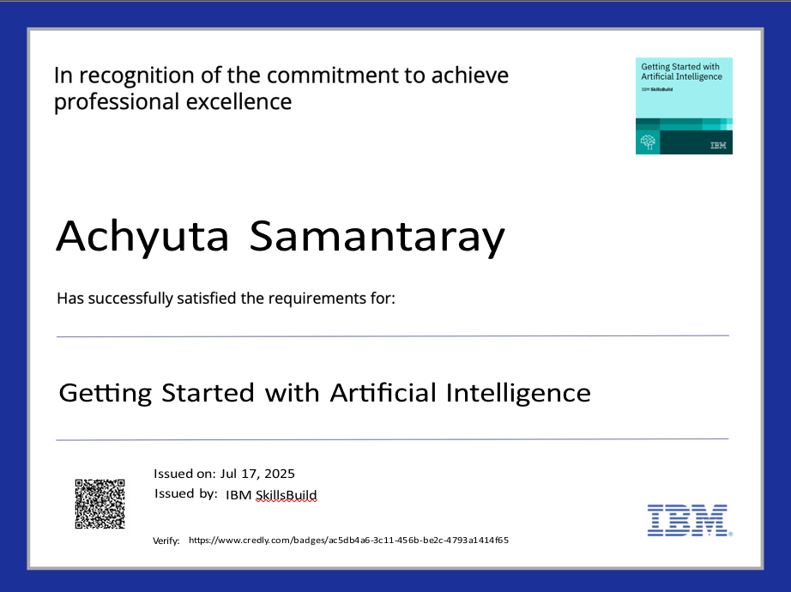
IBM Certifications
Credly certificate (Getting started with AI)

Slide 19
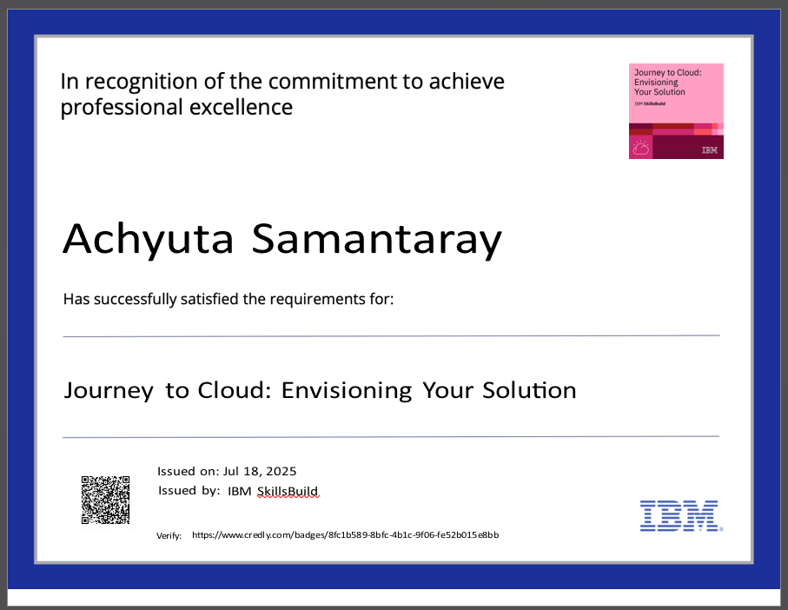
IBM Certifications
Credly certificate (Journey to Cloud)

Slide 20
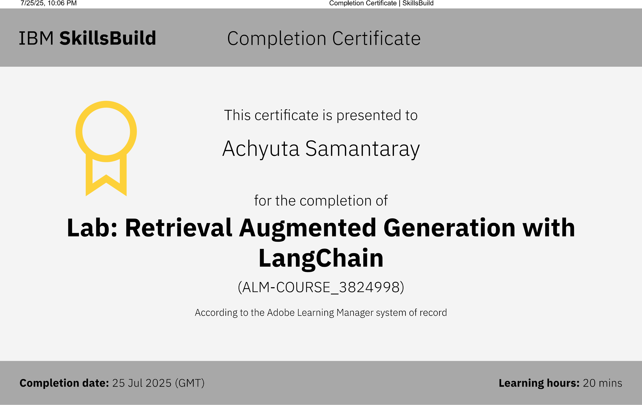
IBM Certifications
RAG LAB Certificate

Slide 21
THANK YOU

